Slide 1
Structural Variants (SVs) and Copy Number Variants (CNVs) using long-read May 11 2025 Slide adapted from Dr. Tobias Rausch - EMBL
Phuc Loi Luu, PhD
Email: Luu.p.loi@googlemail.com
Zalo: 090102182

Slide 2
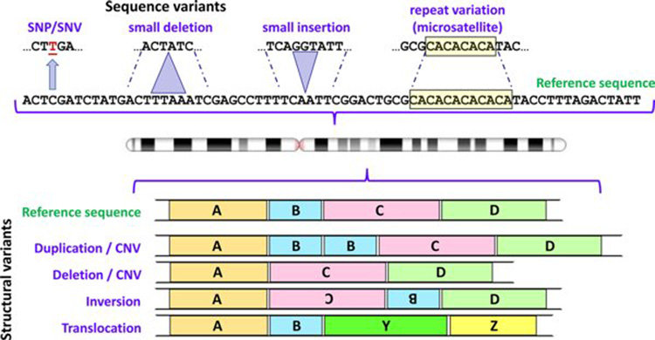
Type of variants
10.1042/EBC20170053

Slide 3
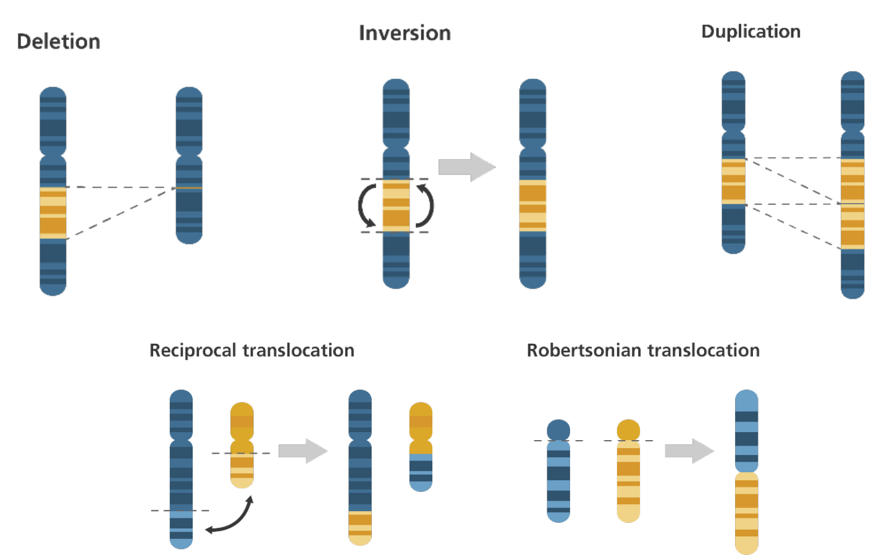
Somatic and Germline Structural Variants (SVs)

Slide 4
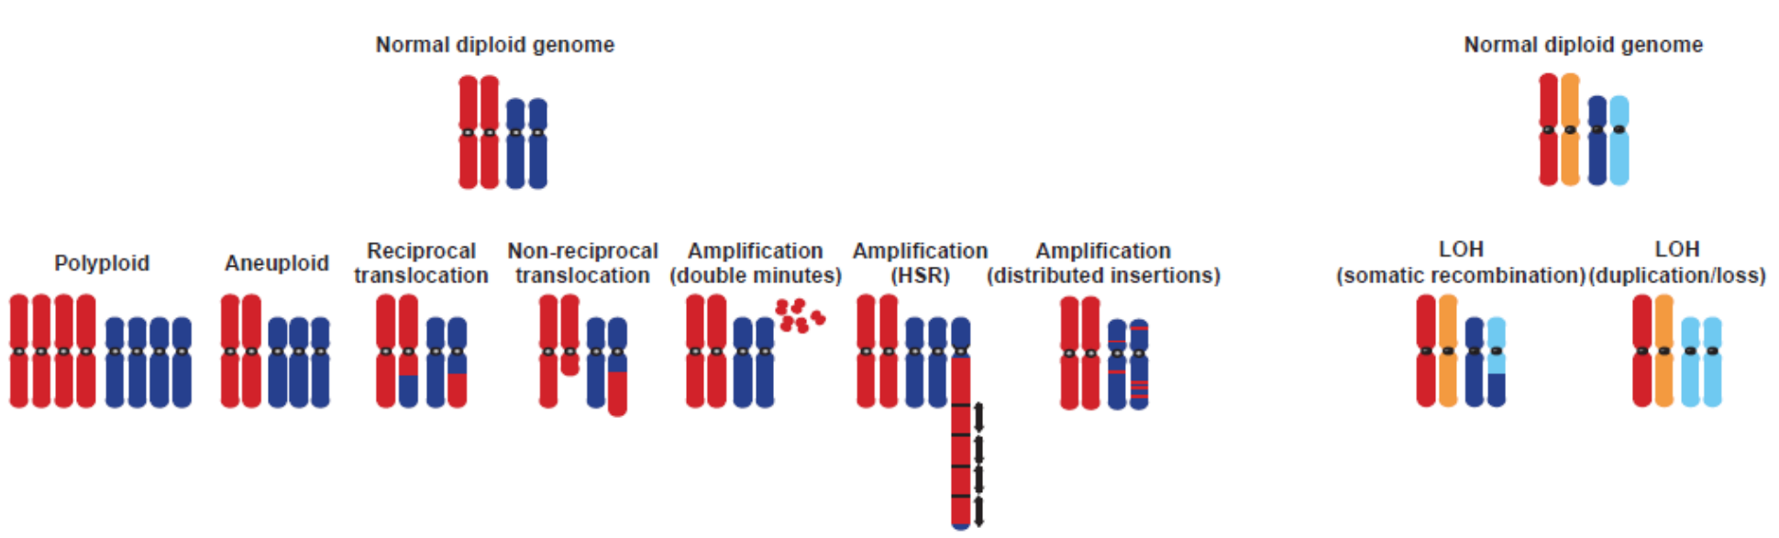
Cancers harbour a wide Range of Chromosome Aberrations
Chromosome aberrations in solid tumors. Albertson et al., Nat Genet. 2003 Aug;34(4):369-76.

Slide 5
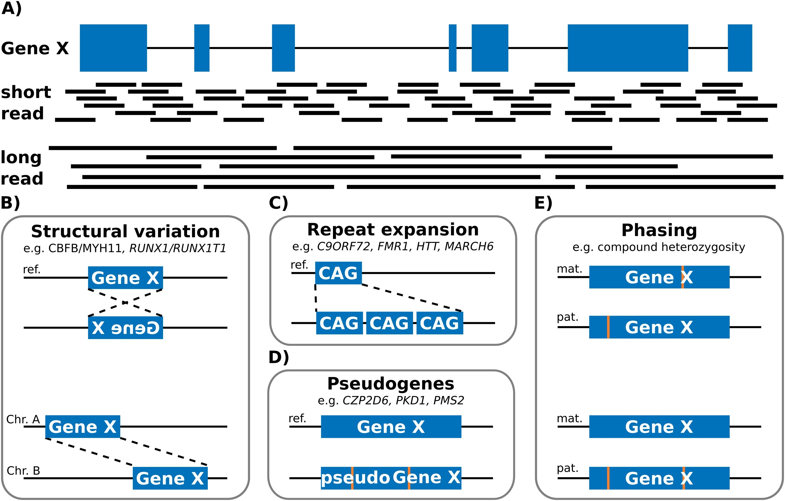
Short Read vs Long Read
https://www.cnblogs.com/wangprince2017/p/13756018.html

Slide 6
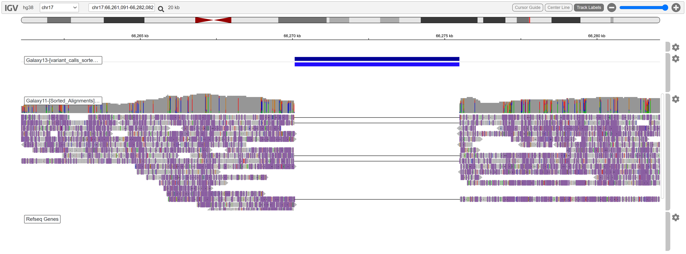
A large deletion in chromosome 17 from 66270K and 66276K
https://www.melbournebioinformatics.org.au/tutorials/tutorials/longread_sv_calling/longread_sv_calling/

Slide 7
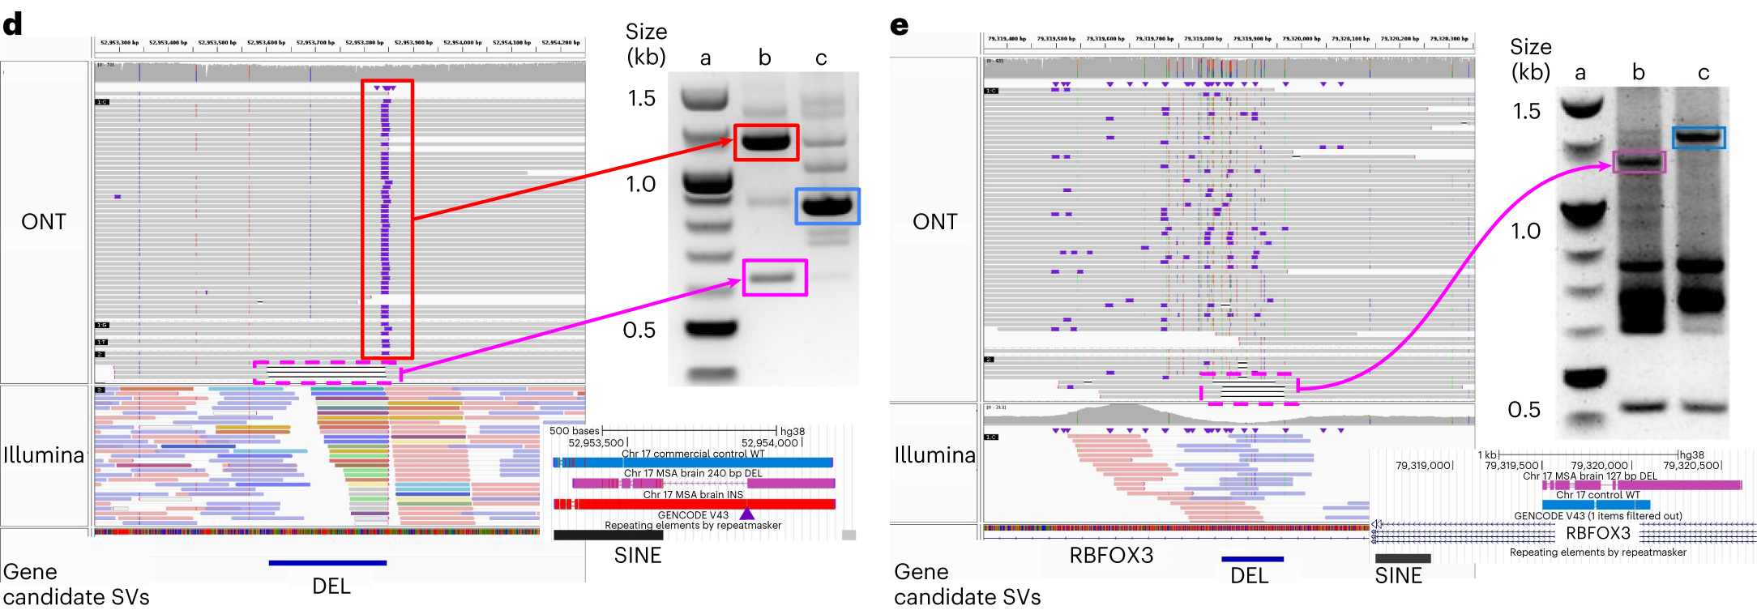
Recovery of somatic SVs using the Sniffles2 mosaic mode
https://www.nature.com/articles/s41587-023-02024-y/figures/4

Slide 8
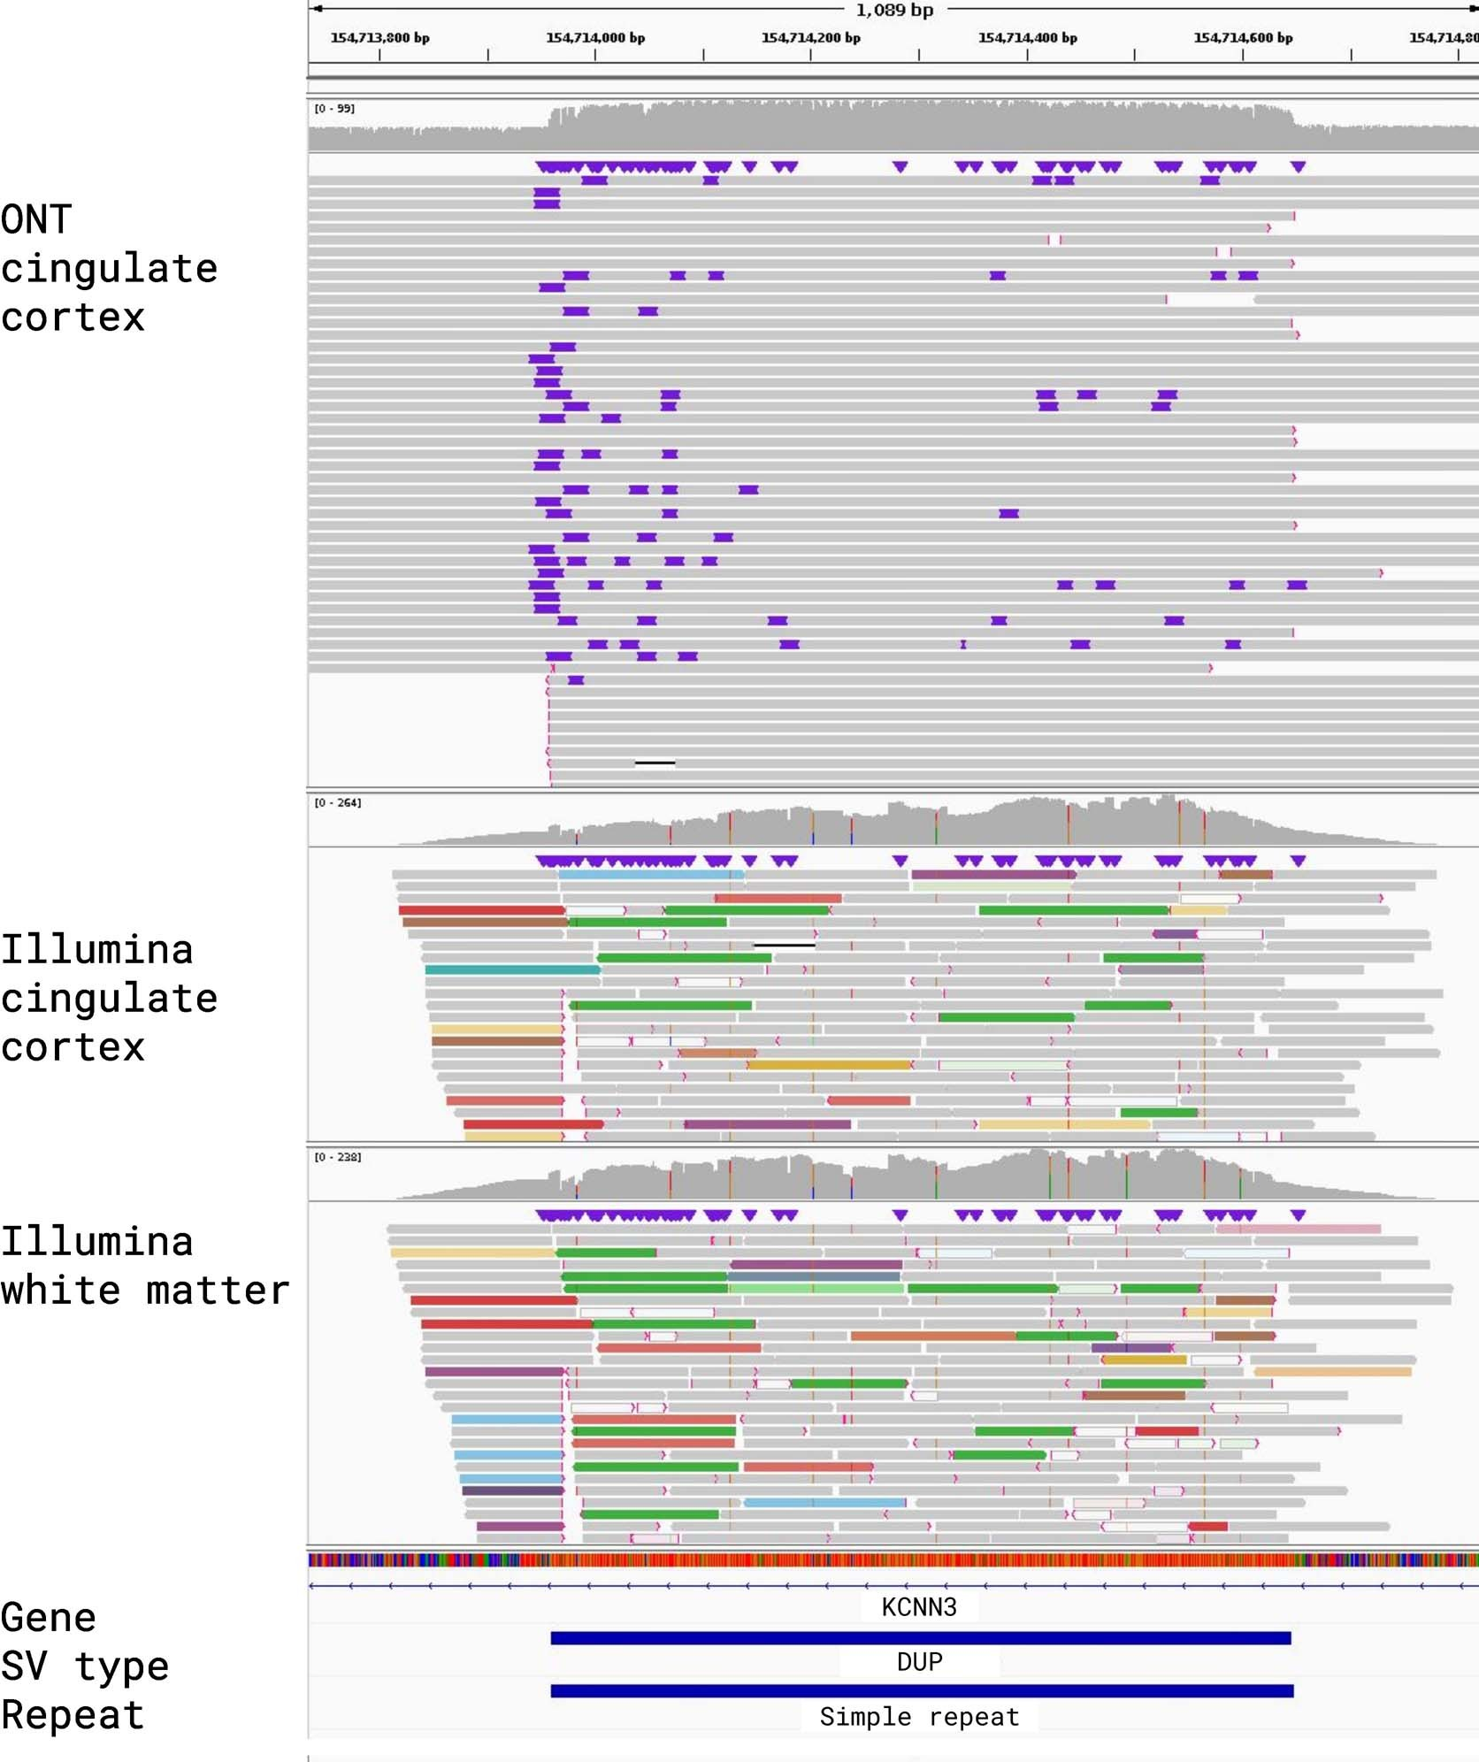
IGV alignments for a Structural Variant that was called by Sniffles2 but not represented in either the Bionano or Illumina call sets
https://www.nature.com/articles/s41587-023-02024-y/figures/8

Slide 9
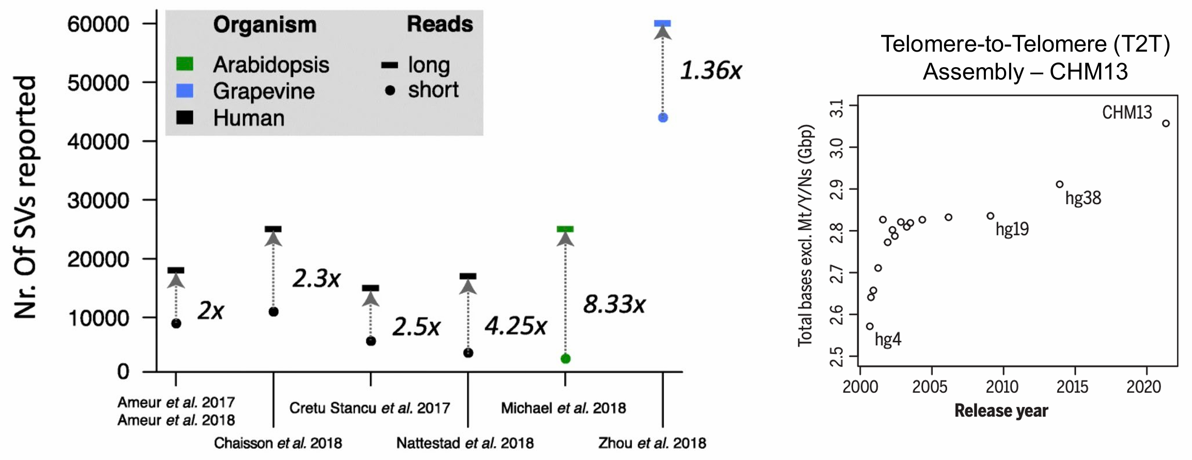
Germline SV detection using short-reads is largely incomplete!
https://doi.org/10.1186/s13059-019-1828-7
https://doi.org/10.1126/science.abj6987

Slide 10
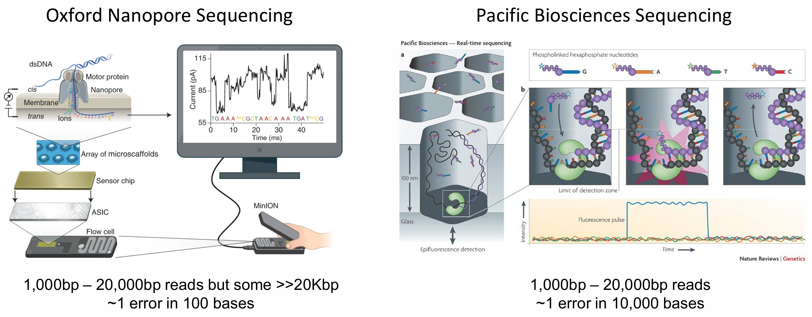
Oxford Nanopore Technologies (ONT) and Pacific Biosciences (PacBio)

Slide 11
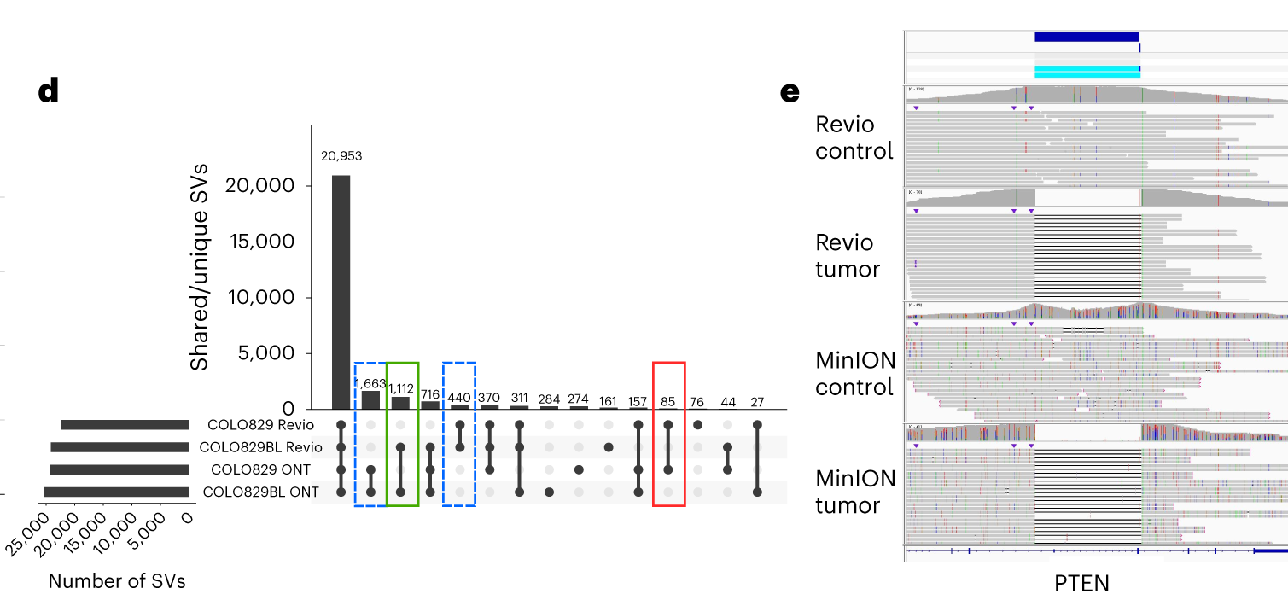
Recovery of somatic SVs using the Sniffles2 mosaic mode
https://www.nature.com/articles/s41587-023-02024-y/figures/5

Slide 12
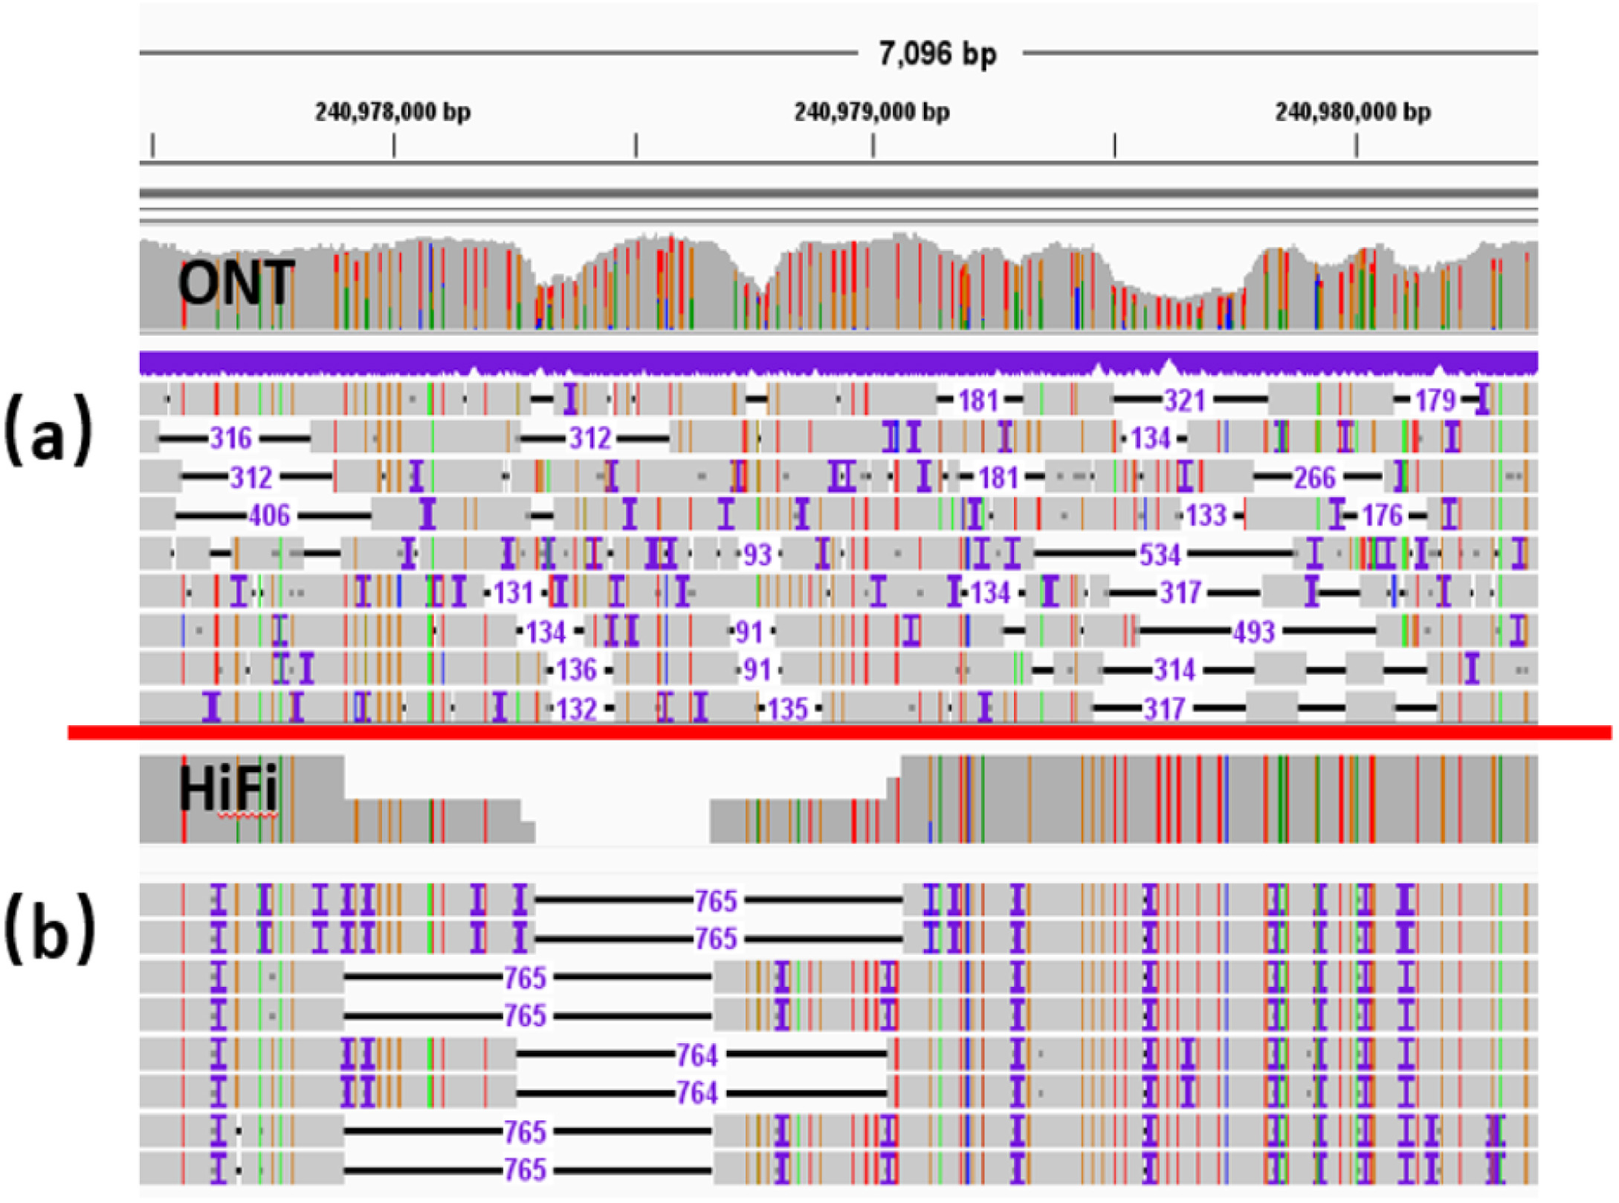
The HiFi Pacbio long reads give the correct DEL of size 765 bp
https://www.sciencedirect.com/science/article/pii/S0010482523003086

Slide 13
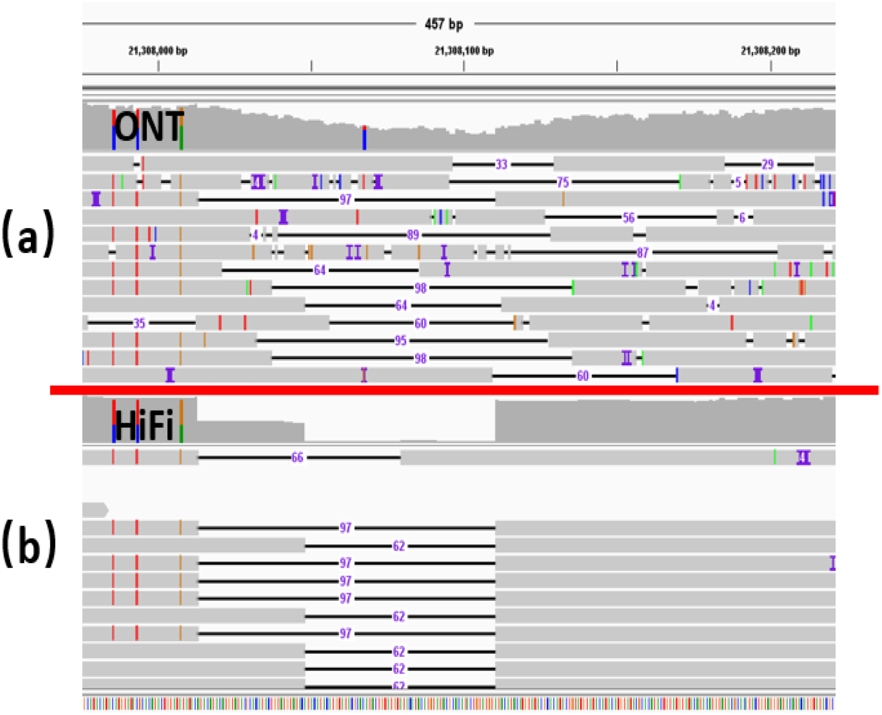
The HiFi Pacbio long reads give the correct two multi-allelic DELs of sizes 97 bp and 62 bp
https://www.sciencedirect.com/science/article/pii/S0010482523003086

Slide 14
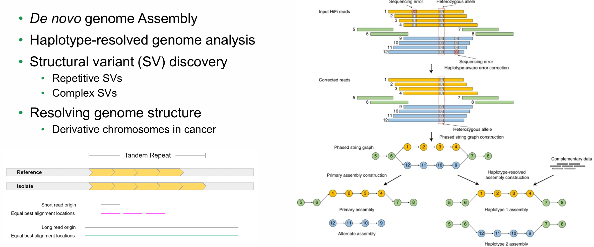
Long read applications
https://www.nature.com/articles/s41592-020-01056-5

Slide 15
Pan-genome for Structural Variants (SVs)

Slide 16
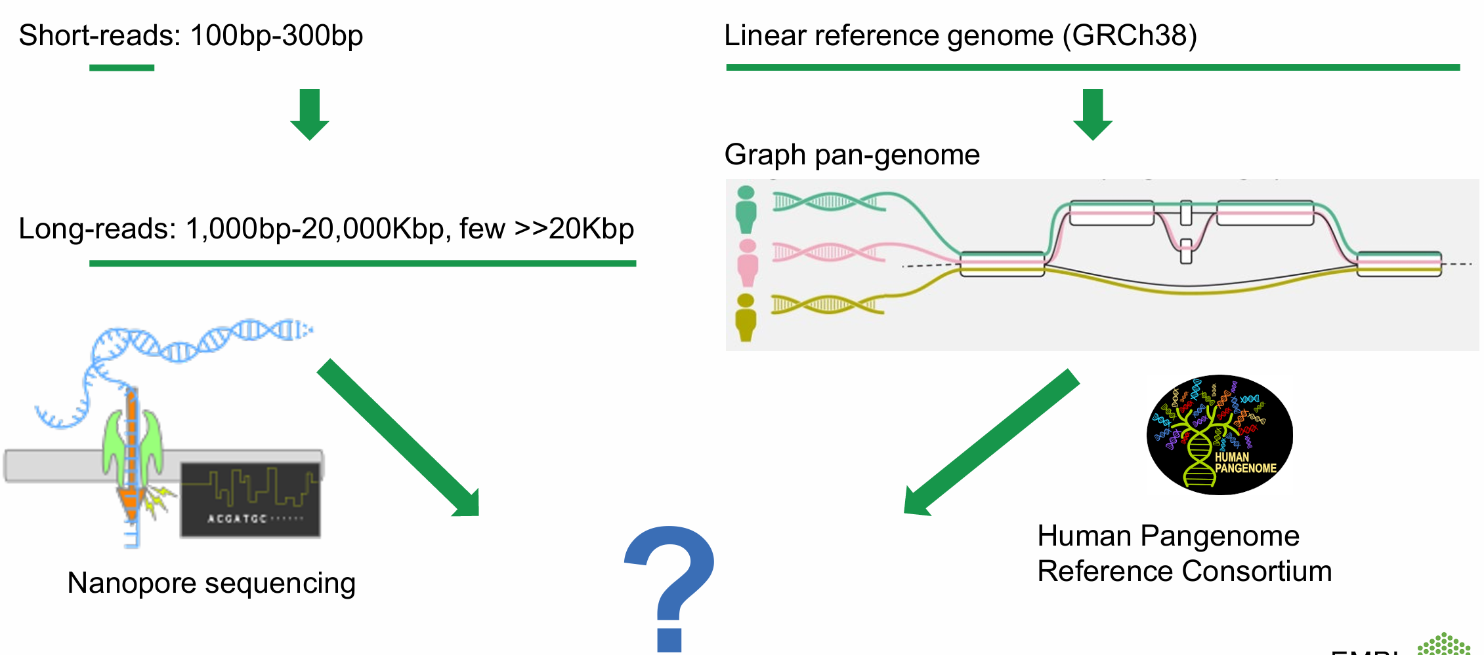
Long-reads and T2T references for SV discovery

Slide 17
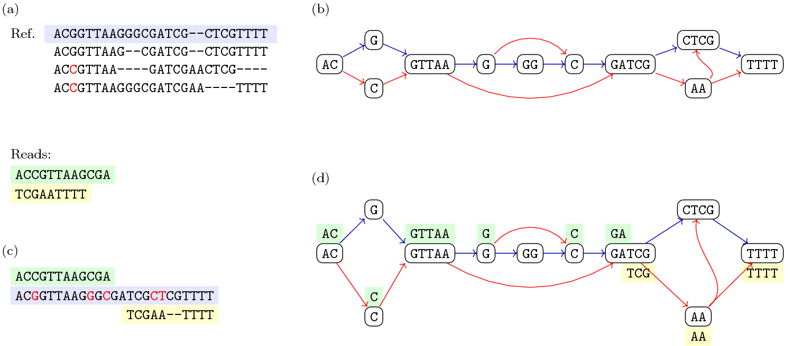
Pan-genomic Alignment Example
https://link.springer.com/article/10.1007/s11047-022-09882-6/figures/1

Slide 18
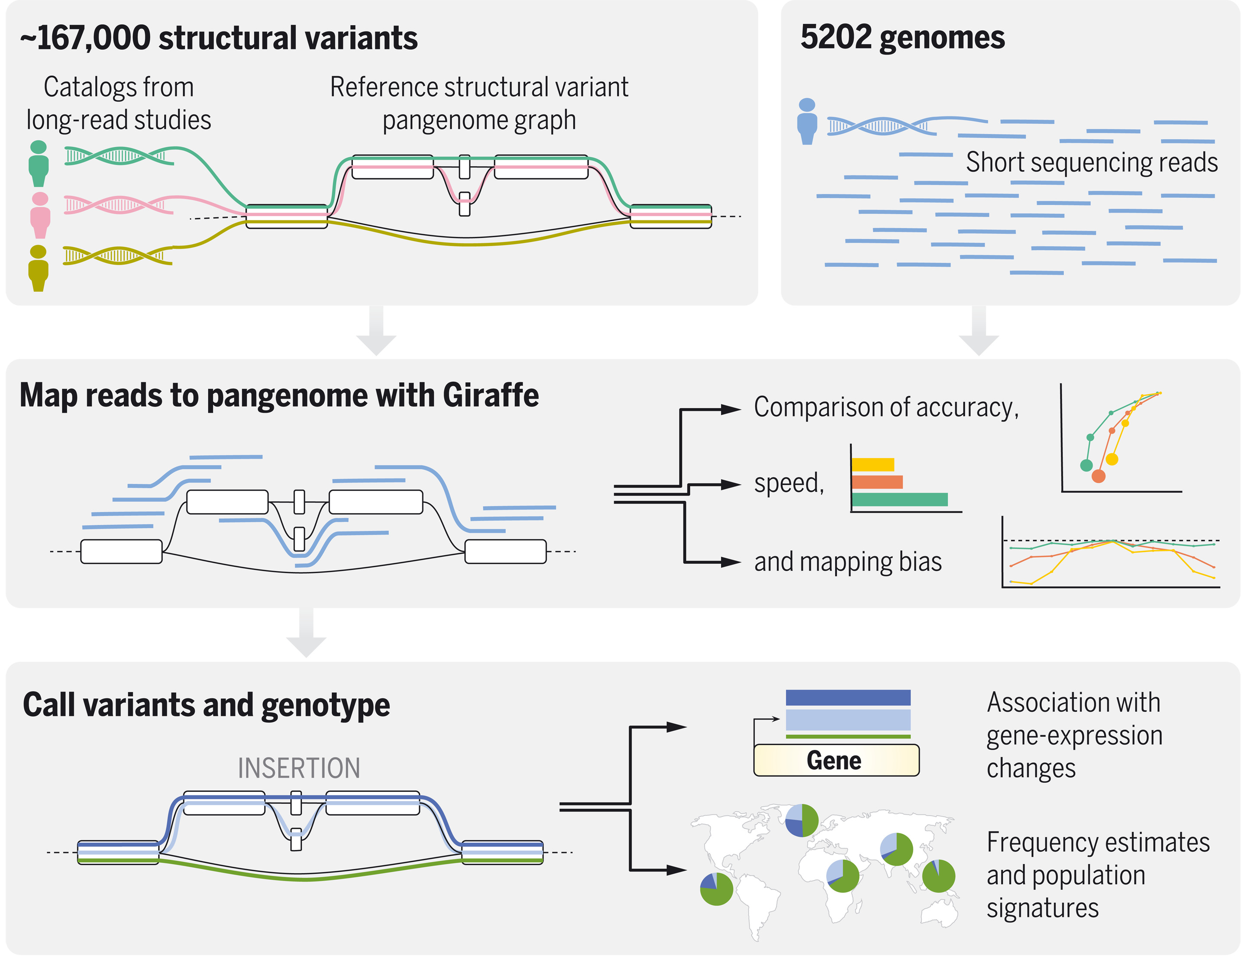
Pangenomics enables genotyping of known structural variants in 5202 diverse genomes
https://www.science.org/doi/abs/10.1126/science.abg8871

Slide 19
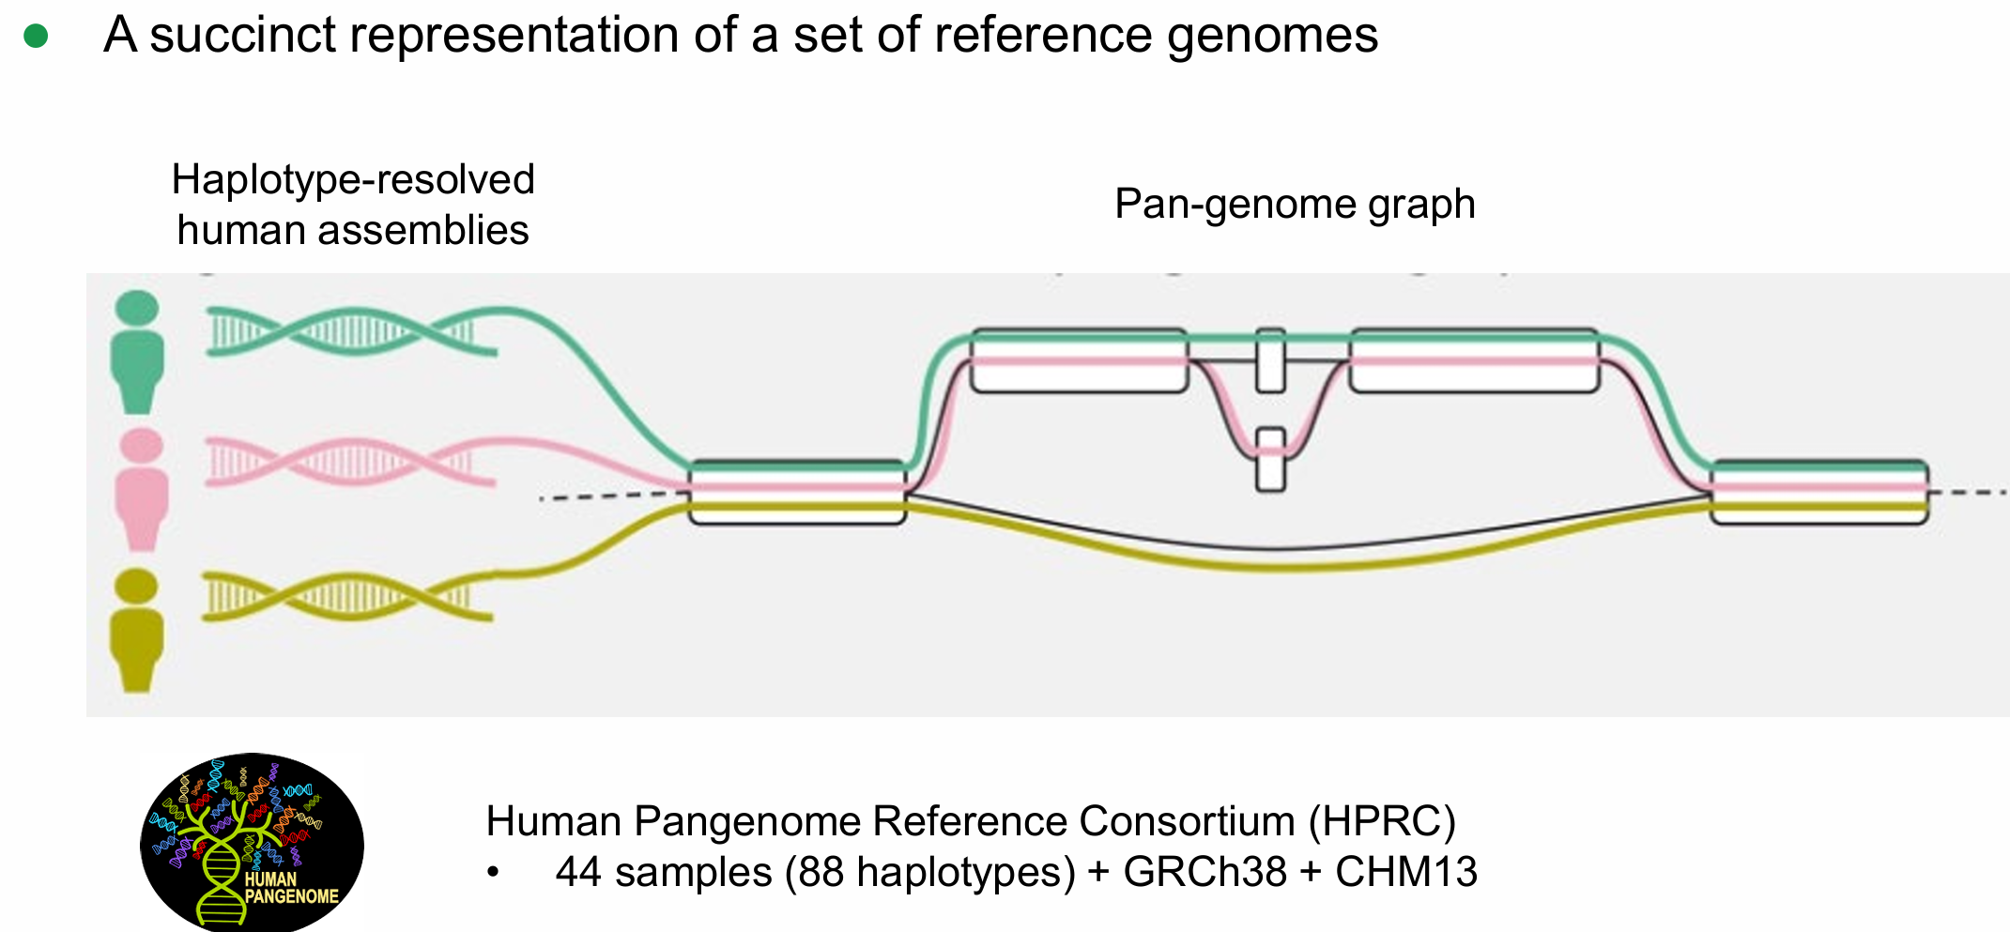
Pan-genome graphs
https://doi.org/10.1126/science.abg8871

Slide 20
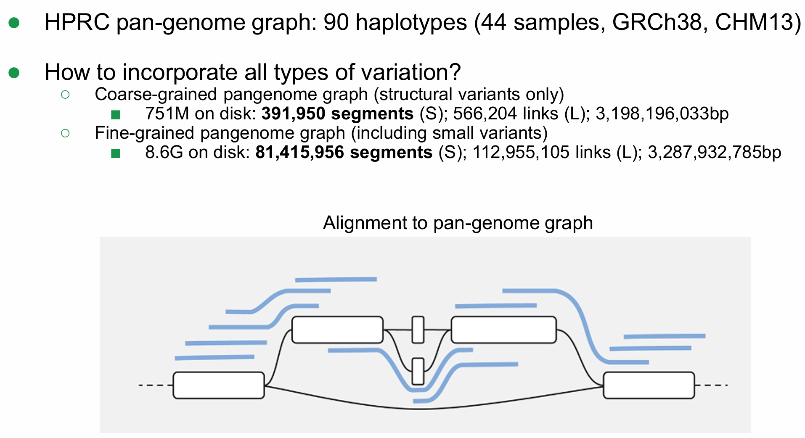
Pan-genome graphs
https://github.com/lh3/minigraph
https://doi.org/10.1126/science.abg8871

Slide 21
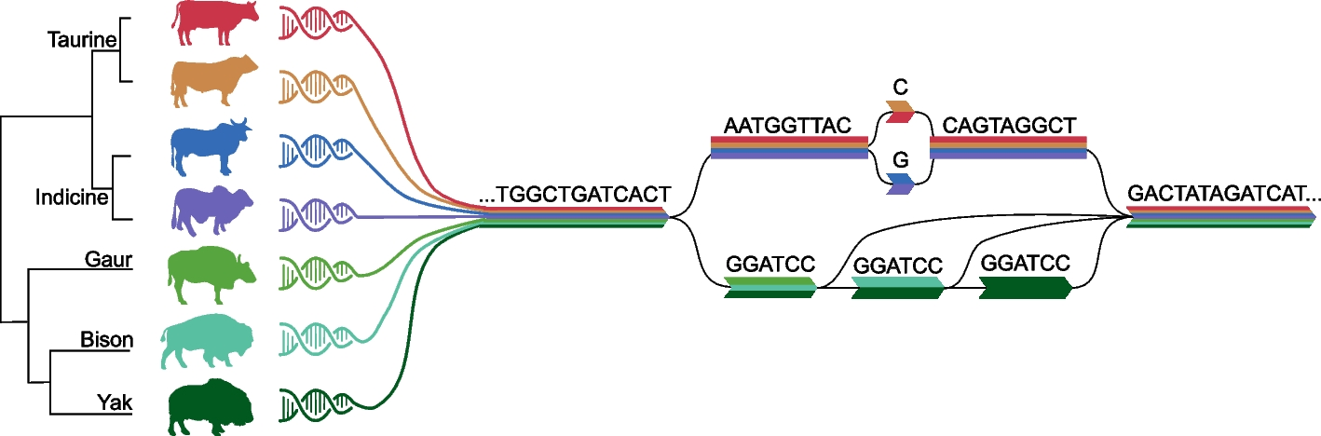
Pan-genome graphs
https://genomebiology.biomedcentral.com/articles/10.1186/s13059-023-02975-0

Slide 22
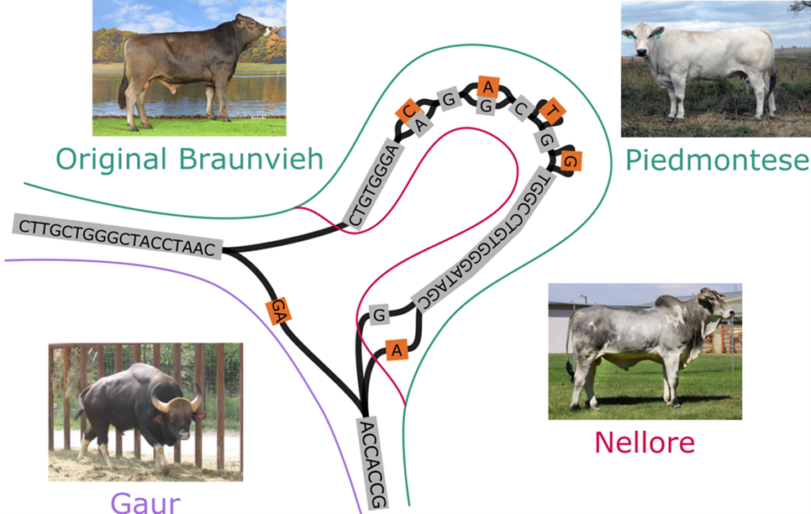
Pan-genome graphs
https://usys.ethz.ch/en/news-events/news/archive/2022/06/pangenomes-reveal-differences-between-cattle-and-their-wild-relatives.html

Slide 23
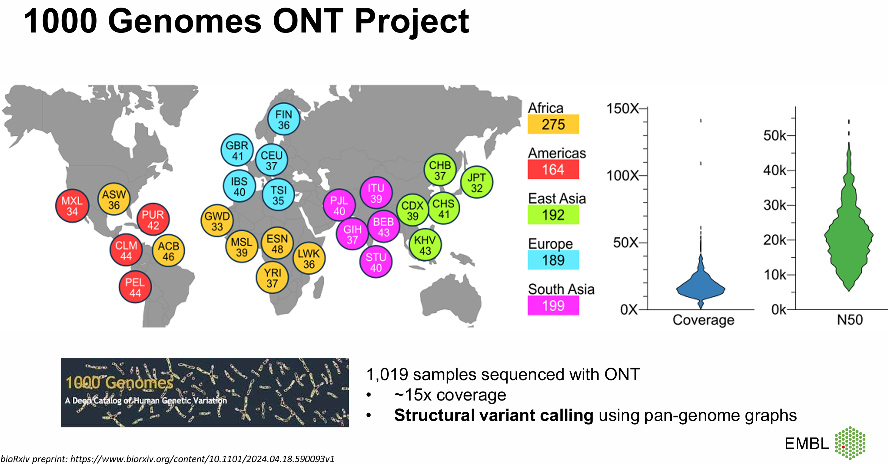
Genome variation discovery using long reads and graph genomes

Slide 24
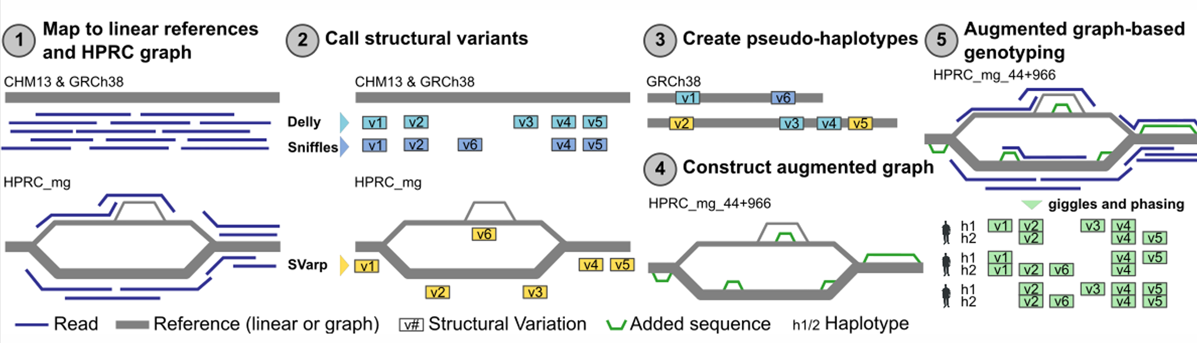
Variant Calling Strategy

Slide 25
Cancer Predisposing SVs

Slide 26
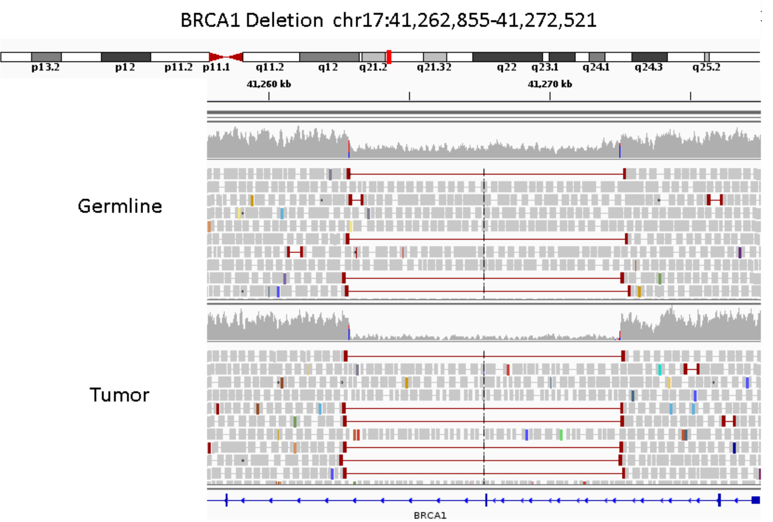
Copy Number Variants (CNVs)

Slide 27
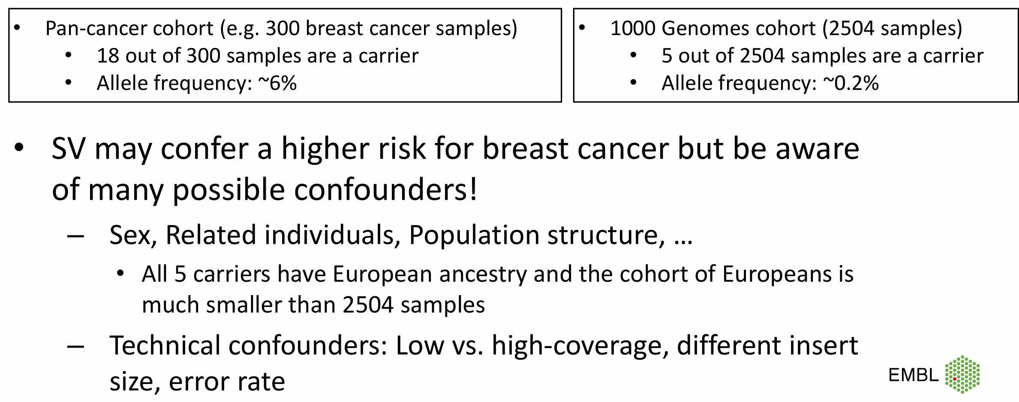
Hypothetical Example: Deletion that affects geneX

Slide 28
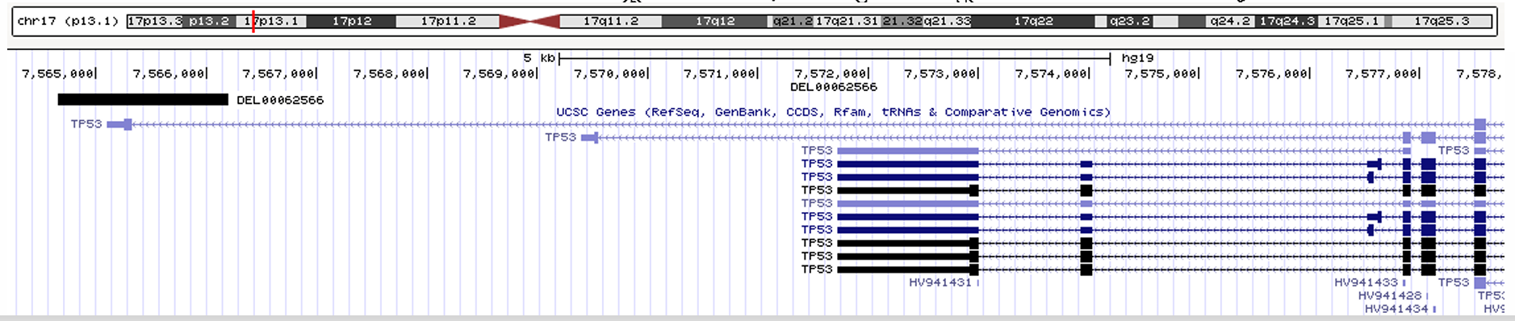
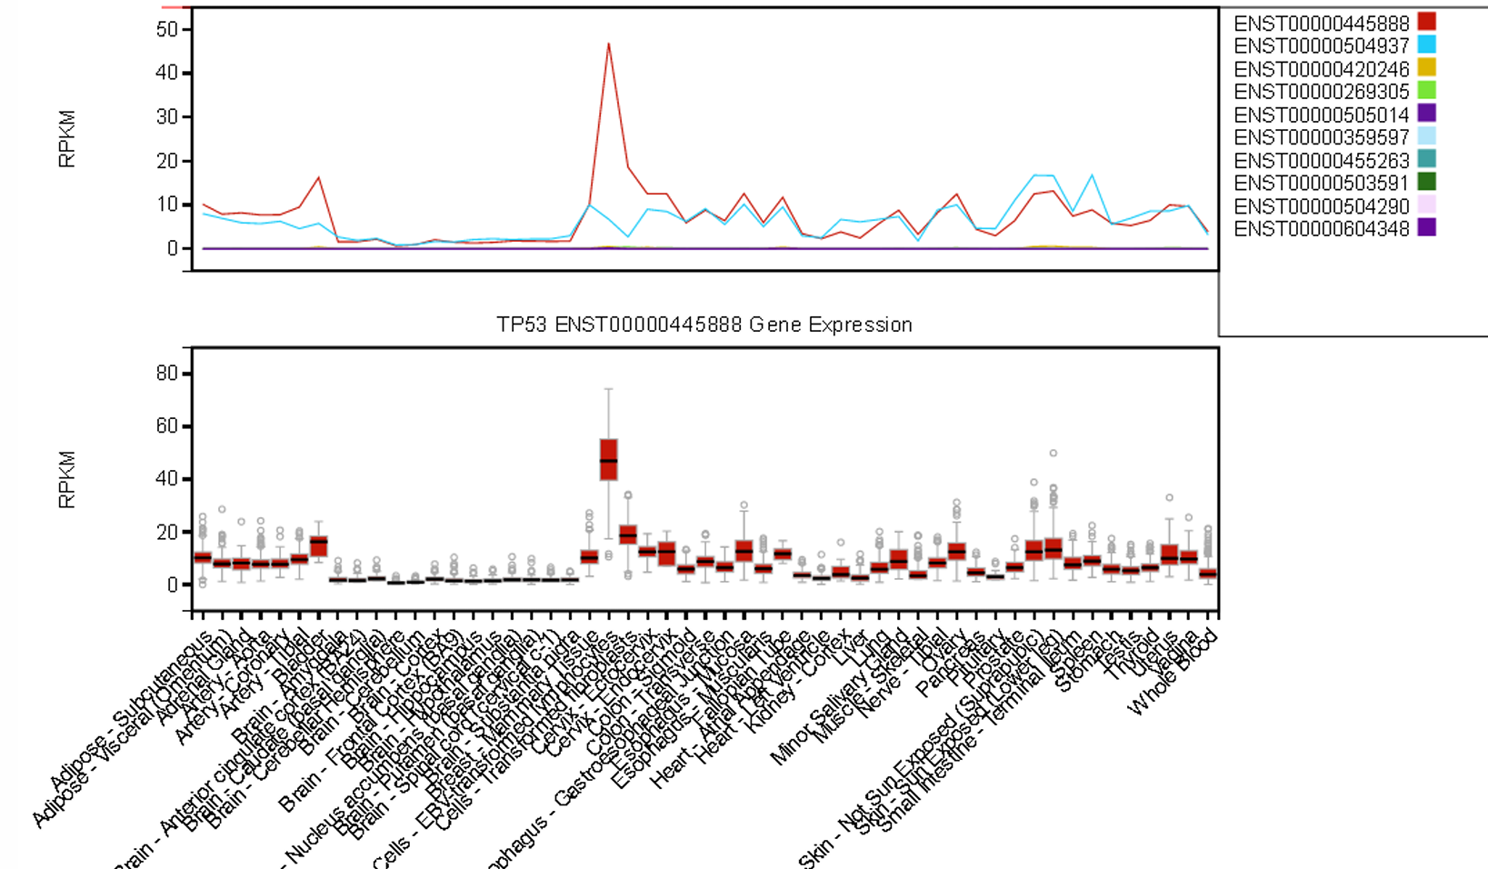
Structural variants affecting genes
GTEx Portal: Genotype-Tissue Expression https://gtexportal.org/home

Slide 29
Thank you!
Phuc Loi Luu, PhD
Email: Luu.p.loi@googlemail.com
Zalo: 090102182

